Slide 1

Walchand College of Engineering
(Government Aided Autonomous Institution)
Vishrambag, Sangli, 416415
Department of Computer Science & Engineering
Presentation on
1947
Used Car Price Prediction Model
AY:2023-24
Team Members:
21510047: Aniket Rahul Khare
21510055 : Aditya Pralhad Kumbhar
21510044 : Prathamesh Sidram Basapure
Under the guidance of
Prof. N. N. Mudegol mam
Date: 8-12-2023

Slide 2
Agenda
Abstract
Problem statement
Objectives
Methodology
UML diagrams
Technology stack
Implementation/Results
Outcomes/Applications
Conclusion
References

Slide 3
Abstract
Create a machine learning model to predict used car prices by analyzing key factors like maker, model, year, mileage, etc. This enhances decision-making for buyers and sellers in the second-hand car market, improving pricing accuracy and transparency.

Slide 4
Problem statement
The dynamic nature of the used car industry, influenced by variable market trends and varying car conditions, poses a challenge for accurate price estimation. Overcoming this challenge involves leveraging machine learning and data science algorithms to analyze past transaction data, providing a more precise basis for determining car prices for potential buyers.

Slide 5
Objectives
Develop a precise and efficient model for user-input-driven used car price estimation.
Achieve high precision in the price predictions.
Design a user-friendly interface that seamlessly takes user inputs and provides accurate price forecasts for enhanced usability.

Slide 6
Methodolgy
We gathered comprehensive used car data with details like make, model, year, mileage, power, name, brand.
We cleaned the data which had missing values as well very small values or undefined values with the help of pandas library.
We then identified and selected impactful features, discarding less relevant ones for efficiency.
By applying and testing the results of various algorithm we then choose multiple Linear Regression in our Model.
We then evaluated model’s performance using r2_score and selected the model which gave maximum r2_score.
Create a user-friendly interface for input collection and integrate the trained model for real-time predictions.

Slide 7
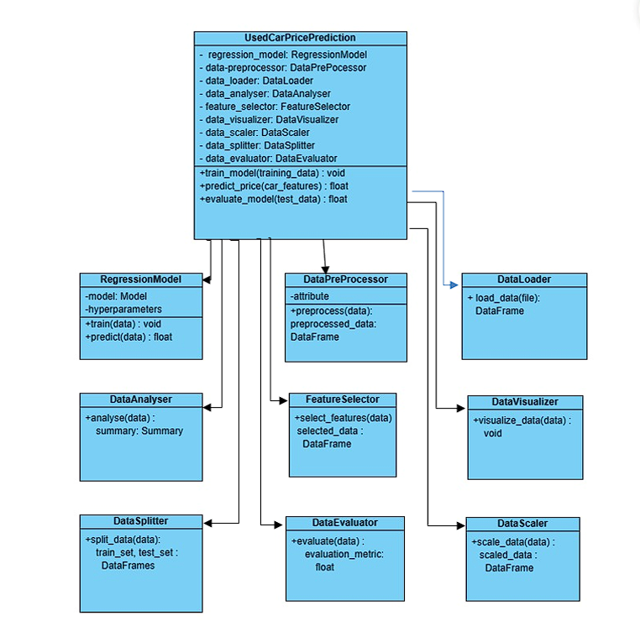
UML Diagram \
.

Slide 8
Technology Stack \
SOFTWARE & HARDWARE SPECIFICATION
Frontend Framework: HTML, CSS, and JavaScript for frontend implementation. Backend Framework: Flask (Python) for backend implementation. Jinja script Data Manipulation and Visualization: NumPy, Pandas, and Matplotlib. Model Implementation: Scikit-learn, and Pickle. Programming Language: Python, JavaScript. Algorithms and Techniques: Utilizing Linear Regression as a baseline model for benchmarking.

Slide 9
Implementation/results
R-square score, MSE, RMSE errors are used to evaluate the model. Following results are achieved from there.
R-square score : 0.9053702889269817
MSE : 0.140622580303109
MAE : 0.3749967737236002
The R-square of training data is almost 90% with a low RMSE which indicates that model is trained efficiently.

Slide 10
Outcomes/Applications
Smart Decisions: Helps buyers and sellers make informed choices in the used car market.
Clear Pricing: Promotes fairness and transparency in negotiations with data-backed pricing.
Optimized Selling: Sellers can maximize value by adjusting prices based on real-time data.
Easy to Use: Simple interface makes it accessible for everyone involved.
Smooth Transactions: Minimizes uncertainty, building trust between buyers and sellers.

Slide 11
Conclusion
.
The used car price predictor simplifies transactions, promotes fair pricing, and aids decision-making for buyers and sellers. Its user-friendly approach and real-time insights contribute to a smoother and more transparent experience in the dynamic used car market as well it makes use of Machine Learning and Data Science algos to study the market trends and correctly predict the price of the used car.

Slide 12
references
[1]Data Set:
https://www.kaggle.com/datasets/avikasliwal/used-cars-price-prediction?select=train-data.csv
[2] Boston housing price prediction case study in python:
https://thinkingneuron.com/python-case-studies/

Slide 13
Thank You

